Slide 1
Managing
Time For Speed and Prioritization
Prof. Parul Rishi PhD (Psychology)
Faculty of Human Resource Management
Adjunct Professor-Management- University of Zululand, SA
Expert Consultant - Environmental Psychology, Aix Marseille University , France, drparulrishi@gmail.com

Slide 2
Time vs. Success
Being successful doesn’t make you manage your time well.
Managing your time well makes you successful.

Slide 3
The Problem of Managing Time
By some estimates, people waste about 2 hours per day due to following:
  Messy desk and cluttered files
  Can’t find things
  Un prepared,
  Try to do things which other people should do
  Tired/unable to concentrate

Slide 4
The 80/20 Rule
Good administration in judiciary system comes from time and experience
And having the Art of identifying trivial vs critical issues and accordingly allocating time.
Critical witness/case details/administrative tasks are few (20%) and the trivial distracting unnecessary details/activities are many(80%).
So time spent should be reverse ,i.e, 80% on 20% critical details and 20% on 80% trivial details .
However, in practice, it is reverse.

Slide 5

Get it All Done
Peter Drucker says:
Work where you are the strongest 80% time
Work where you are learning 15 % time
Work where you are the weakest 5% time

Slide 6
From Reasonable Time to Optimal Time Frame
CASES ARE MANAGED AND DISPOSED IN DUE TIME
Without any Undue Delay
Time line of Judicial Administration
Without Compromising the Quality and Fairness of Judgment

Slide 7
Tools to Measure Time Management
Quantification
How Much Delay?
Causal Analysis
Whether causes unavoidable/ Avoidable?
Accountability for delay
Who is accountable for delay?
What caused delay?

Slide 8
How to Manage Time???
Time
Planning
through
Time
Frames
for
Timely
Judicial Administration

Slide 9
What is Time Frame???
Tool to achieve the timeliness of different activities under Judicial administration
Timeframes have to fit in the contingencies of the “local administrative culture”
Having timeframes is a prerequisite for evaluating the results of the efforts made by administration to reduce the lengths of judicial proceedings.

Slide 10
Timeliness of Judicial Administration (J Adm)
Setting realistic and measurable time frame for each JAdmn activity
Enforcing Time Frame
Monitoring Time Frame

Slide 11
How Time Framing Helps???
Time Framing goals- shared and pursued by all through stakeholders’ participation
To Help Build Common Commitment among Key Players
To Help Build Environment for Development of Innovative/time effective Practices
Help Build the culture of Shared responsibilities rather than blame game
CONSIDERING THE LOCAL LEGAL CULTURE

Slide 12
Examples of Time Framing Across the world
Finland- Optimum timeframes for each type of cases are agreed and Targets for case processing are set for which J Adm plays a crucial role.
Slovenia – court sets a timeframe of 18 months after the case has been presented before the court. If a decision is not taken within 18 months, the case is considered delayed. The head of court may ask the judge in charge of the case to report the circumstances why a decision has not been reached and that explanation has to be build up by J Admn after analyzing the complete scenario.
Sweden − targets for civil and criminal cases are set up by the Government. All units within the court define their targets and J Admn plays a crucial role to ensure meeting of targets.

Slide 13
Setting of timeframes for kind of procedure
Denmark− 58% of the civil cases should be disposed within 1 year, 63% of the criminal cases should be disposed within 2 months and 95% within 6 months.
Norway − Timeframes are proposed by the Ministry of Justice with consent from the Norwegian Parliament. As of today, 100% of civil cases should be disposed in six months, 100% of criminal cases in three months. J Admn remains at their toes to make it happen.

Slide 14
Setting timeframes in collaboration with justice stakeholders
The building and maintenance process of setting realistic timeframes must involve the stakeholders at the different levels (state, court, J Admn).
Setting timeframes is not a once for all event, but it has to be a continuous process built through consensus and shared objectives between the stakeholders.

Slide 15
Enforcing the timeframes
Timeframes are not designed and implemented in a vacuum.
They are organisational tools that, in order to give the expected results need to be shared and supported by the stakeholders and, in particular, by the people who work in the organisation.
Therefore it is necessary to create an organisational environment to support and enforce timeframes, which will be affected by the institutional setting of the justice system (e.g. structure of the judiciary, role of the chief justice, sensitiveness about judges’ internal independence etc.).
Also, other agencies and the bar associations should support the enforcement, which should also be mentioned in the ethical rules for lawyers.

Slide 16
Major functions of Judicial Administration
Judicial/Case Record Management
Reports Preparation
Lok Adalat
RTI
Issuance of Cause List/grouping of cases/Listing of Cases
Indexing of Judgment
File Tracking /Management/Delivery of Judicial Files
Preparation of Certified copies of Documents
Preparation of Judicial Calendar
Roaster of Judges

Slide 17
Contd.
Coordination among different courts
Submission of statements regarding case disposal
Ensure Compliance
Supervisory Function
Infrastructure allotment and management
Complaint redressal
Budgetary functions
Analysis of statistical data and quarterly report preparation.
Parliamentary/Assembly questions

Slide 18
Live Above the LINE-
Covey’s Time Management Matrix
Important
Not important
MANAGE Critical Pressing Cases Deadline driven activities Meetings Assembly questions DO IT NOW | AVOID Diverging papers/reports/witness Interruptions, Phone calls Media Interventions DELEGATE
FOCUS Judicial procedural issues Record Management Cause list preparation DECIDE WHEN TO DO | LIMIT Time Wasters Disturbances Unwanted people Unrelated details to confuse DUMP
1
2
Urgent
Not
Urgent
3
4

Slide 19
Exercise 1- How do you spend your Time?
Go back to your last working week.
Record the major activities that you did in the first two days of that week.
Note down in the format provided.
Also note the approximate time spent on each activity.
Note down the total time wasted during those two days in mins/hours.
Who was accountable for that- self,others, situation.
How satisfied you were in the way your time was spent in those two days?
Give rating from 1 as least satisfied to 7 as most satisfied.

Slide 20
Group Exercise
Get into the group of 5.
Discuss your activities in a group.
Place them in either of the four cells of Covey’s TM Matrix.
Analyse the wasted time and discuss if it could have been avoided.

Slide 21
Everyone has Good and Bad Times
Find your important time. Defend it ruthlessly, spend it alone, focusing on important and not urgent woks which require your thinking and full commitment.
Find your dead time. Schedule meetings, phone calls, and mundane stuff during it.

Slide 22
Cutting Things Short
“I’m in the middle of something now…”
Start with “I only have 5 minutes” – you can always extend this
Stand up, stroll to the door, complement, thank, shake hands
Clock-watching; on wall behind them

Slide 23
Using Time Journal Data
What am I doing that doesn’t really need to be done?
What am I doing that could be done by someone else?
What am I doing that could be done more efficiently?
What do I do that wastes others’ time?

Slide 24
Procrastination
“Procrastination is the
thief of time”
Edward Young
Night Thoughts, 1742

Slide 25
Balancing Act
“Work expands so as to fill the time available for its completion”
Parkinson’s Law
Cyril Parkinson, 1957

Slide 26
Comfort Zones
Identify why you aren’t enthusiastic?
Fear of embarrassment
Fear of failure?

Slide 27
Delegation
No one is an island
You can accomplish a lot more with help
Most delegation in your life is from faculty to graduate student

Slide 28
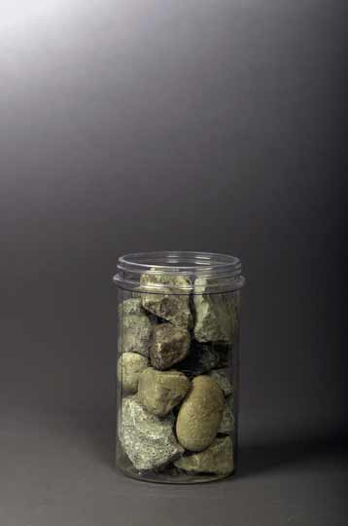
Is The Jar Full?
Stephen Covey in his book, First Things First, shares the following story
"How many of these rocks do you think we can get in the jar?" he asked.

Slide 29
After many guesses, he said, "Okay, Let's find out."
He set one rock in the jar . . . then another . . . then another.
I don't remember how many he got in, but he got the jar full.
Then he asked, "Is this jar full?"
Everyone looked at the rocks and said, "Yes."

Slide 30
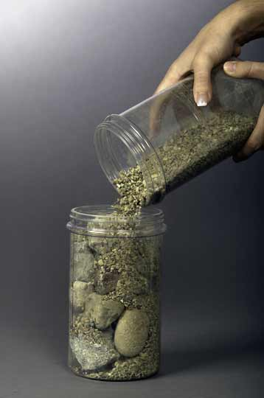
Then he said, "Ahhh" He reached under the table and pulled out a bucket of gravel.
Then he dumped some gravel in and shook the jar and the gravel went in all the little spaces left by the big rocks.
Then he grinned and said once more, "Is the jar full?"

Slide 31
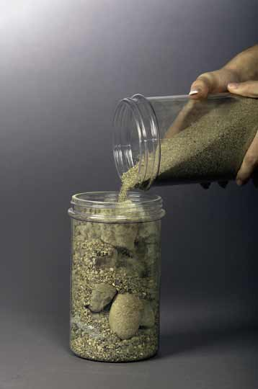
"Probably not,”
He reached under the table and brought out a bucket of sand. He started dumping the sand in and it went into all of the little spaces left by the rocks and the gravel.
Once more he looked and said, "Is this jar full?" "No!" we roared.

Slide 32
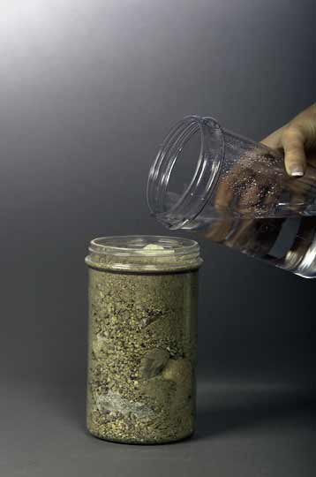
He said, "Good!" and he grabbed a pitcher of water and began to pour it in.
" Well, what's the point?"
Somebody said, "Well, there are gaps, and if you work really hard you can always fit some more things into your life."

Slide 33
"No," he said, "that's not really the point.
The point is this:
Put the
Big Rocks
in First

Slide 34
Priority Listing
A
B
C
of Time Management

Slide 35
How to Get IT Done
20 minutes at beginning of week
  Review your Roles
    Sharpen the Saw –Read and analyse before hand to save time
  Prioritize by Choosing Big Rocks first
    Which is the most important case requiring maximum time and effort? In short, your ABC of Time Management.
  Schedule the Week keeping in mind the reversal of 80/20 Rule
Notes:
FFA needs to Plan Weekly!!!

Slide 36
Thank you
Have a Time Managed
Time For Ever!

